Slide 1

POWERPOINT TEMPLATE
Codebasics Challenge #8
Provide Insights to the Product Strategy Team in the Banking Domain
We would like to offer you a stylish and reasonable presentation that will help you to promote your business

Slide 2

Table of Content
Problem Statement
Model and Tables
Dashboards
Key Features of Dashboard
Insights from Demographic Data
Key Customer Segments
Potential areas and Customer Segments

Slide 3

Problem statement
Mitron Bank is a legacy financial institution headquartered in Hyderabad. They want to introduce a new line of credit cards, aiming to broaden its product offerings and reach in the financial market.
AtliQ Data Services came to know about this through an internal link and approached Mitron Bank with a proposal to implement this project. However, strategy director of Mitron Bank, Mr. Bashnir Rover is skeptical and asked them to do a pilot project with the sample data before handing them the full project. They provided a sample dataset of 4000 customers across five cities on their online spend and other details.
Goal is to analyze the provided sample data and report key findings to the strategy team of Mitron Bank. This analysis is expected to guide them in tailoring the credit cards to customer needs and market trends.
The successful acquisition of this project depends on provided actionable, data-driven recommendations and impress Mr. Bashnir Rover & his team. Also, Manager Tony Sharma provided some ideas to generate insights based on the data provided.

Slide 4

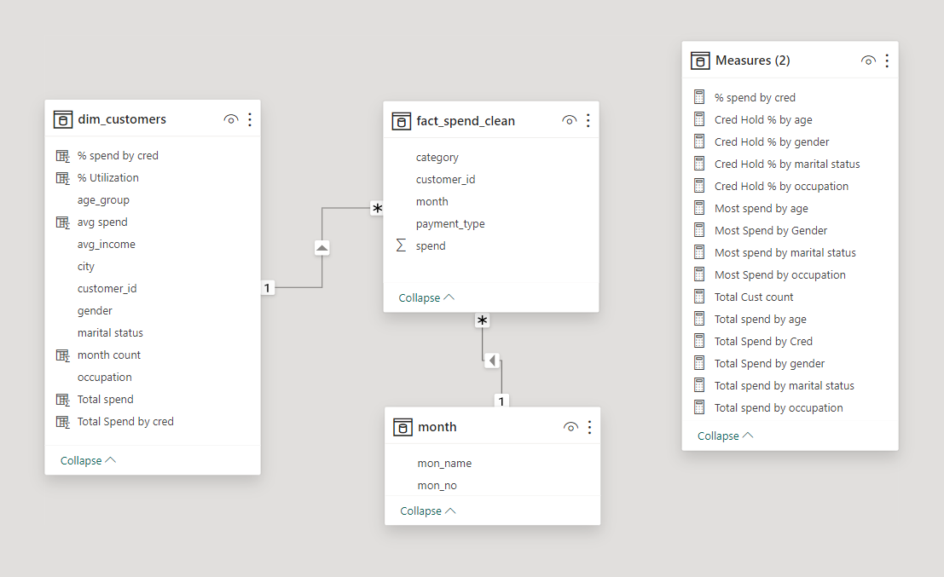
Model and Tables
Tables
dim_customers
Fact_spend_clean
Month
Model
Model –

Slide 5
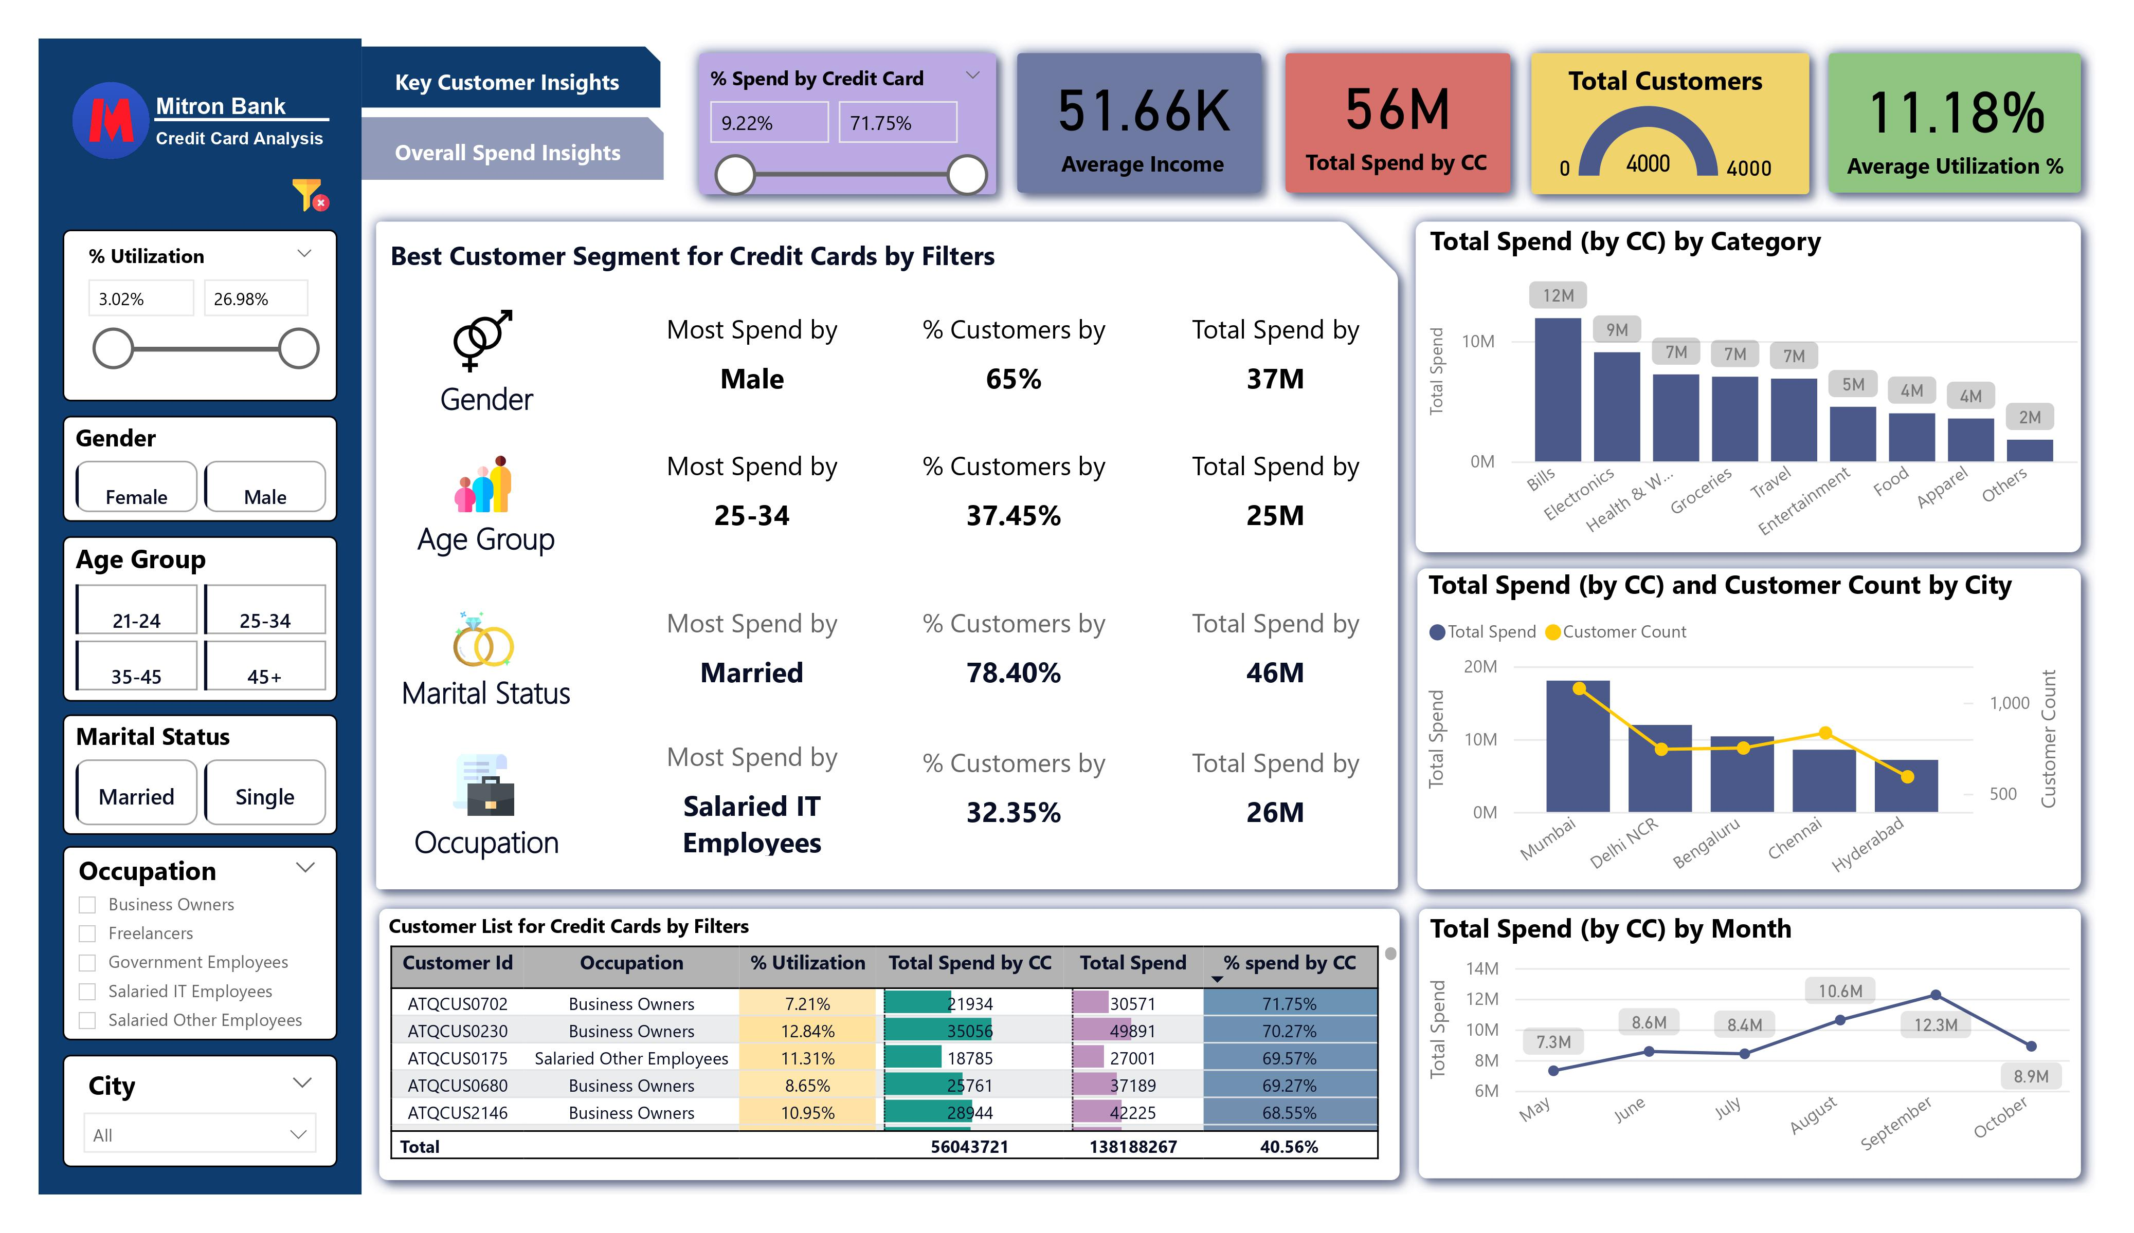
Dashboard – Key Customer Insights

Slide 6
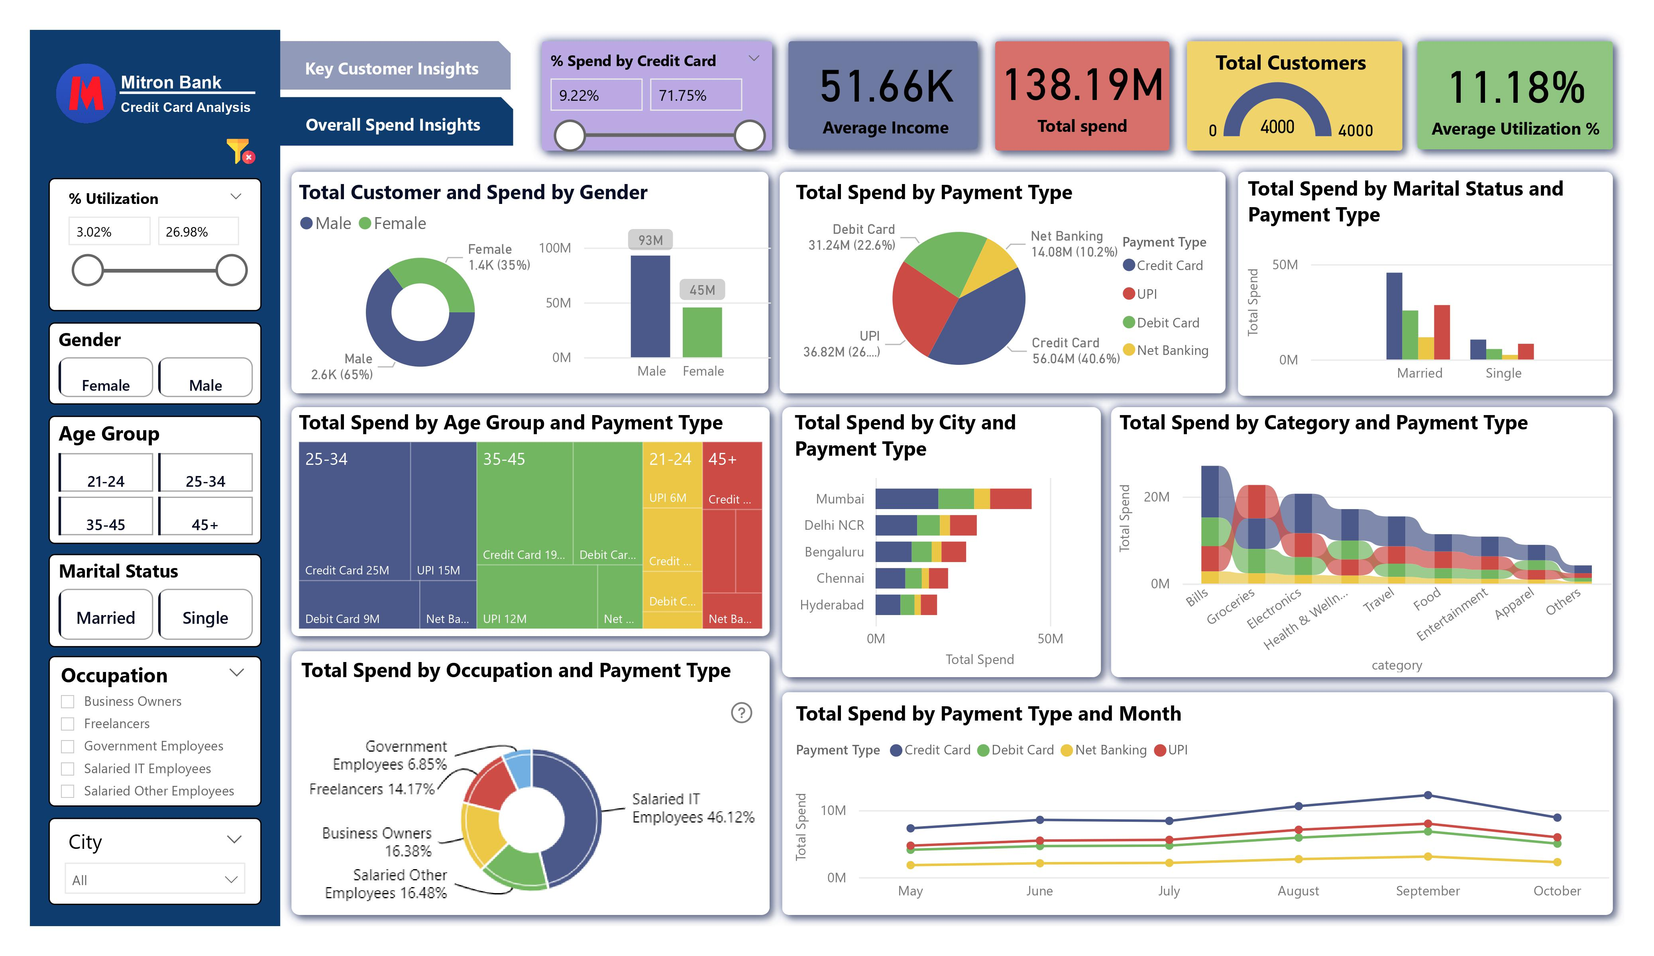
Dashboard – Overall Spend Insights

Slide 7

Key Feature of Dashboard
Demographic Data Filters
Key Metrics
Gender
Age Group
Marital Status
Occupation
City
Average Income
Total spend
Total count of customers
Average Utilization %
Key Filters
% Utilization –
The % Utilization filter categorizes customers based on chosen percentage. It helps gauge how responsibly customers manage their spendings.
% spend by credit card –
This filter helps to highlight segment customers based on the percentage of their total spending done through credit cards. It enables identification of customers based on the proportion of their expenses covered using credit cards in relation to their overall expenditure.
Best customer segment for credit card by filters
This segment provides insights into the highest spenders using credit cards across various demographic categories such as gender, age groups, marital status, and occupation.
It allows navigation through categories, cities or months, pinpointing the optimal segments for specific features. These insights help in identifying
target customers and designing credit card features tailored to their preferences and spending behaviors.
Overall spend insights dashboard
This feature provides comprehensive insights into demographic details in relation to payment methods and total spending. It offers a detailed breakdown, enabling a deep
understanding of how different demographic groups utilize various payment methods and their overall expenditure patterns.

Slide 8
Insights from Demographic data
Total spend – 138M
Total spend by CC – 56M
Customer Count – 4000
Average Income – 51.66k
Average Utilization % - 11.18%
Key metrics
By Gender
No significant variance in spend per customer based on gender.
By marital status
Married Customer contributes 82.14% amount of total spendings.
By Age group
Top two groups collectively spent the 74.53 % of total spendings.
 | Male | Female
% Customers | 65% | 35%
Total Spend by CC | 37M | 19M
Total Spend | 93M | 45M
 | Married | Single
% Customers | 78.4% | 21.6%
Total Spend by CC | 46M | 10M
Total Spend | 111.5M | 26.6M
 | 25-34 | 34-45
% Customers | 37.45% | 31.9%
Total Spend by CC | 25M | 19M
Total Spend | 53M | 49M
By City
Top 3 cities
By Category
Top 5 categories
By Months
Top 3 months
Occupation -
Top three occupations spent 78.98 % of total spendings. Listed below-
Mumbai
Delhi NCR
Bengaluru
Bills
Groceries
Electronics
Health & Wellness
Travel
September
August
October
Salaried IT Employees - 46.12 %
Salaried Other Employee - 16.48 %
Business Owners - 16.38 %

Slide 9
Key Customer Segments
Most Spending Customers Segment by groups
The most spending customer segments show significant impact on total expenditures
Age Group – 25-34 & 35-45
Spent 44M which is 78.57 % of total spendings
Marital Status – Married
Spent 46M which is 82.12 % of total spendings
Occupation – Salaried IT Employees
Spent 26M which is 46.42 % of total spendings
Ideal Customers Segment
The customers within this segment exhibit high credit utilization, frequent credit card usage, and substantial spending patterns.
Age group – 25-34 & 35-45
Marital Status – Married
Occupation - Salaried IT Employee
Spent 19M which is 33.92 % of total spendings
Top spending categories by group
Identifying the top spending categories of ideal customers helps discern their spending
preferences and facilitating the design of credit card features aligned with their specific
behavioral patterns and needs.
Young Customer Segment
The customer segment aged 21-24, despite not being high spenders overall at 6
million, displays distinct preferences in top spending categories, emphasizing
Entertainment, Electronics, and Apparel. These preferences should be considered
when designing credit card features for this demographic.
Top Spending by categories –
Entertainment
Electronics
Apparel
Male & 25-34
Top 5 spending categories
Bills
Electronics
Groceries
Travel
Entertainment
Male & 35-45
Top 5 spending categories
Bills
Electronics
Groceries
Health Wellness
Travel
Senior Customer Segment
The senior customer segment, aged 45 and above, exhibits high average income and
responsible % utilization. However, their spending via credit cards falls below 50%.
Targeting life essential categories like Bills, Health & Wellness, and Travel could help
increase their credit card usage percentage among this group.
Top expenditure by categories –
Bills
Health & wellness
Travel
Female & 25-34
Top 5 spending categories
Bills
Travel
Health & Wellness
Electronics
Groceries
Female & 35-45
Top 5 spending categories
Health & Wellness
Bills
Travel
Electronics
Groceries

Slide 10

Potential areas and Customers segments
Discovering customer segments with growth potential and identifying areas for enhancing credit card usage by crafting card features based on insightful analysis.
Chennai: Despite a significant customer base, Chennai's per-customer spending rate lags behind other cities. Elevating awareness, crafting targeted offers, and tailoring features to suit local market needs can enhance spending in Chennai.
Freelancers: Top spenders among freelancers demonstrate high utilization but low credit card usage, favoring other payment methods. Encouraging more credit card use can be achieved by introducing appealing offers in their primary spending areas: health and wellness, groceries, and entertainment.
Groceries Category: Credit card usage remains low in the groceries category, with customers preferring alternative payment methods. Stimulating credit card use in this category can be achieved through specific incentives for groceries and partnerships with platforms specializing in groceries sector.

Slide 11



Thank You !
www.linkedin.com/in/vaibhav-mehendale-725371194
https://github.com/Vaibs24?tab=repositories

